Slide 1

TELECOM CUSTOMER CHURN PREDICTION
Mohamed Affan M
Notes:
To use this title animation slide with a new image simply 1) move the top semi-transparent shape to the side, 2) delete placeholder image, 3) click on the picture icon to add a new picture, 4) Move semi-transparent shape back to original position, 5) Update text on slide.

Slide 2
INTRODUCTION
In this project, we analyze a dataset from a telecom company to predict customer churn.
The dataset includes various features such as customer demographics, account information, and service usage details.
By building machine learning models, we aim to identify key indicators of churn and predict which customers are likely to leave. This analysis will help in developing targeted retention strategies to minimize churn and improve overall business performance.
Customer churn, or the rate at which customers stop using a service, is a critical metric for businesses, particularly in the highly competitive telecom industry. Understanding the factors that lead to customer churn enables telecom companies to develop strategies to retain customers, thereby reducing revenue losses and enhancing customer satisfaction.

Slide 3
OBJECTIVE
Build a predictive model to identify the types of customers most likely to churn.
Use of appropriate chatbot frameworks for developing functionalities
Perform EDA to understand key trends, distributions, and patterns within the data
Assess algorithm performance with key metrics like accuracy, precision, recall, and F1 score.

Slide 4
Methodology Used
1
2
3
4
5
Data collection
Importing Dataset and necessary Libraries
Data Cleaning and Preprocessing
Exploratory Data Analysis
Model Building
Reference : The basics you can find anywhere 5 Steps To Successful Storytelling Published on April 5, 2014 Featured in: Marketing & Advertising

Slide 5
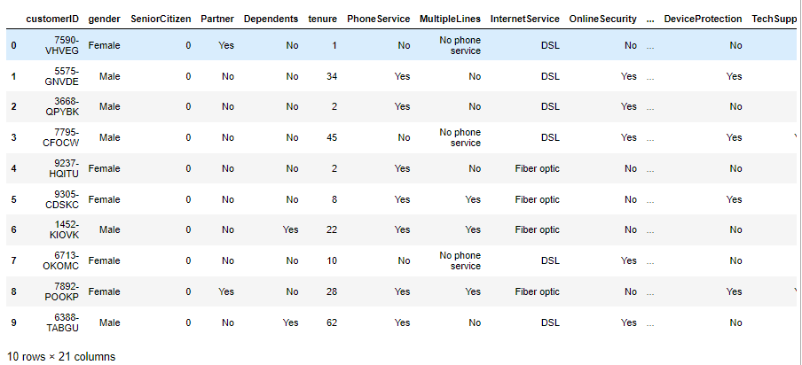
IMPORTING
DATASET
Below is the image displaying the variables and dataset generated using Python. The Dataset contains 7043 records and 21 variables.

Slide 6
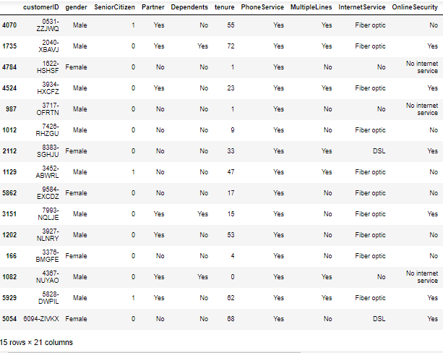
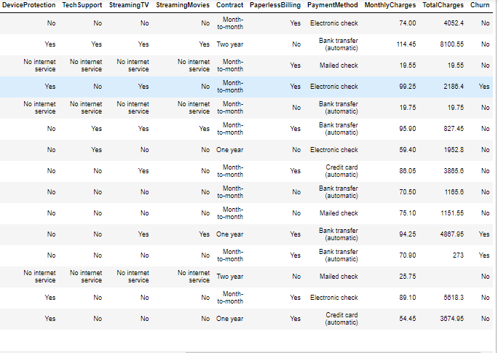
DATA CLEANING
&
PREPROCESSING
Printing 15 random data from dataset to see if there are any anomalies or missing values

Slide 7
DATA CLEANING
&
PREPROCESSING
Feature Removal: The CustomerID' column is dropped from the dataset as it might not significantly contribute to the classification task.
Data Type Transformation: Converting Total Charges into numeric data type as all the values present in that variable are numeric.
Handling Missing Values : In our case I am dropping the missing values as the percentage of missing value is very less.
Label Transformation: Senior Citizen contain 0 & 1 instead of Yes/No. Converting it into Yes/No for better interpretability

Slide 8
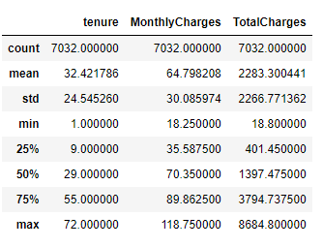
EXPLORATORY
DATA
ANALYSIS
Descriptive Statistics is a numerical method of extracting information from data. The numerical variables’ values are summarized in the descriptive statistics.
In our dataset we have three numerical variable tenure, monthly charges and total charges
OBSERVATION : It is clearly obvious looking at the distribution above that our data has no outliers. The quantity is gradually increasing.

Slide 9
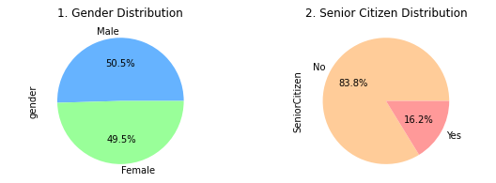
EXPLORATORY
DATA
ANALYSIS
GENDER DISTRIBUTION
Male and female ratio are equal in our dataset.
SENIOR CITIZEN DISTRIBUTION
There are only 16% senior citizen in our dataset and rest are young.

Slide 10
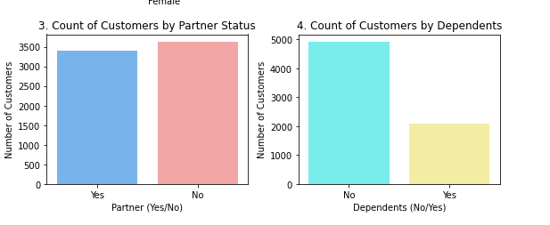
EXPLORATORY
DATA
ANALYSIS
PARTNER STATUS
From our graph we can see that around then 3500 customers have partners and similar count don't have partner.
DEPENDENTS STATUS
From our graph we can see that less then half of the customers don't have dependents.

Slide 11
EXPLORATORY
DATA
ANALYSIS
PARTNER STATUS
From our graph we can see that around then 3500 customers have partners and similar count don't have partner.
DEPENDENTS STATUS
From our graph we can see that less then half of the customers don't have dependents.

Slide 12
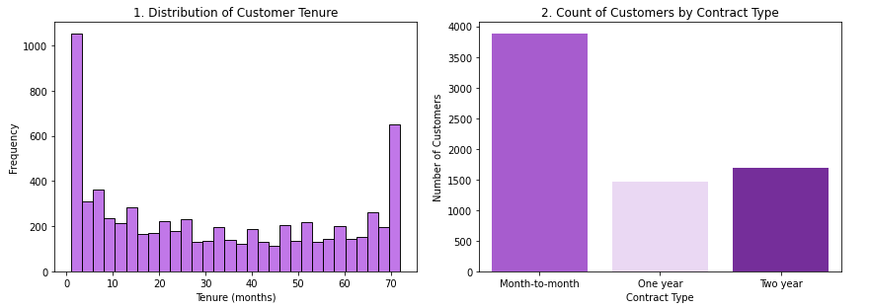
EXPLORATORY
DATA
ANALYSIS
CUSTOMER TENURE
From the histogram we can see most of the customers had tenure of month or two and few have tenure of more then 70 months.
CONTRACT TYPE
The graph shows around 4000 customers opted for month-to-month contact and equal amount have one and two year contract

Slide 13
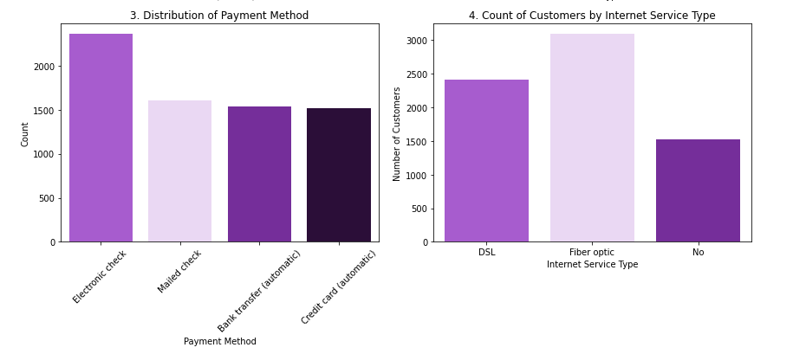
EXPLORATORY
DATA
ANALYSIS
PAYMENT METHOD
More then 2000 customer prefer electronic check and significant amount of customers prefer other payment options provided by the company.
INTERNET SERVICE TYPE
DSL(Digital Subscriber Line) and fiber optic are the two internet service provided by the company and most of them use fiber optic connection.

Slide 14
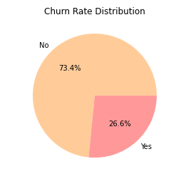
EXPLORATORY
DATA
ANALYSIS
CHURN RATE DISTRIBUTION
Pie chart shows the churn rate of the customer from the company. Only 26% customers got churned which shows good hold of customers by the company.

Slide 15
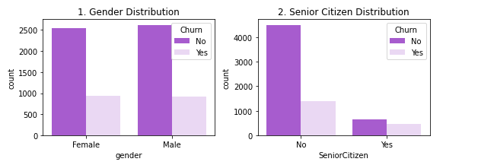
EXPLORATORY
DATA
ANALYSIS
GENDER DISTRIBUTION WITH CHURNED CUSTOMER
From the Graph we can see that equal number of male and female customer got churned, which shows gender is not the reason of separation from the company.
SENIOR CITIZEN DISTRIBUTION WITH CHURNED CUSTOMER
Graph shows senior citizen have less churn rate compared to young customers.

Slide 16
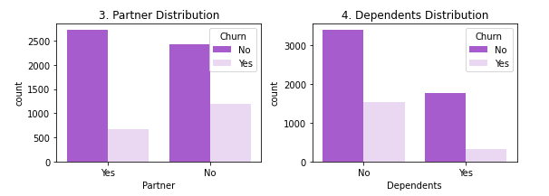
EXPLORATORY
DATA
ANALYSIS
PARTNER DISTRIBUTION WITH CHURNED CUSTOMER
Customers with no partners have a higher churn rate. This shows that having a partner might be one of the reason for customers to stay with the company.
DEPENDENTS DISTRIBUTION WITH CHURNED CUSTOMER
Customers with no dependents tend to have a higher churn rate compared to those who have dependents. Dependents may be the reason to stay with company for longer period.

Slide 17
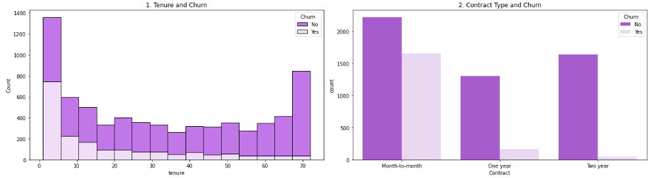
EXPLORATORY
DATA
ANALYSIS
TENURE WITH CHURNED CUSTOMER
Customer tenure and contract has a inverse relation. The customers with shorter tenure or tenure less than 5 months have higher churn rate. The churn rate decreases with increase in tenure.
CONTRACT TYPE WITH CHURNED CUSTOMER
Customers with Month-to-Month contracts shows a higher churn rate compared to those with longer-term contracts. So the company should emphasize customer on choosing longer-term contracts to reduce churn rate

Slide 18
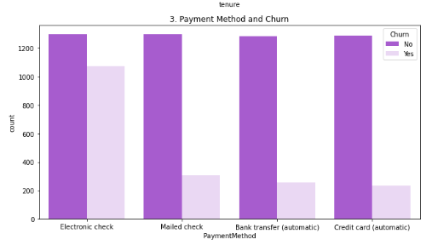
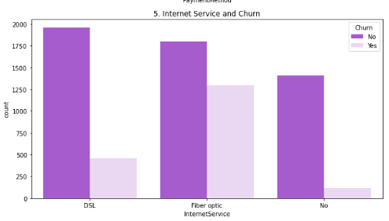
EXPLORATORY
DATA
ANALYSIS
PAYMENT METHOD WITH CHURNED CUSTOMER
Customers using Electronic Check as their payment method have a higher churn rate compared to those using Mailed Check, Bank Transfer or Credit Card.
INTERNET SERVICE TYPE WITH CHURNED CUSTOMER
Customers with Fiber Optic connection have the highest churn rate, indicating a possible dissatisfaction among Fiber Optic users leading to churn.

Slide 19
FEATURE
ENGINEERING
I used three feature encoding techniques in my project. Standard Scalar, Label Encoding and One-Hot Encoding
StandardScaler: This feature engineering technique is used on numerical variables, It is used to ensure features contribute equally to model performance.
One-Hot Encoding: Converts categorical variables into a binary matrix where each category is represented by a separate column; used to handle nominal data without assuming any ordinal relationship. In short it is used when there are more then two classes without any ordinal relationship.
Label Encoding: Assigns a unique integer to each category in a categorical variable; used for ordinal data or when a model can naturally handle numerical categories. This encoding technique is used when we have two categories(ex: Yes/No, 0/1)

Slide 20
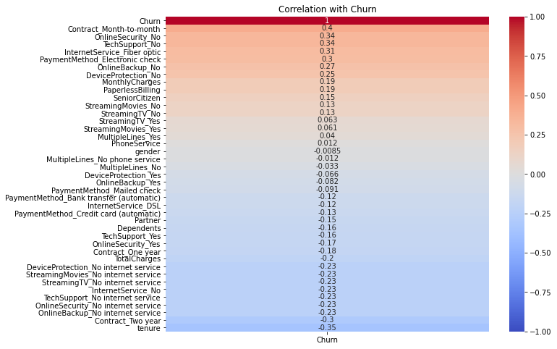
CORRELATION
MATRIX
Correlation with respect to Churn
The highest correlation is the Contract_Month-to-month variable, so Contract_Month-to-month has higher churn rate.
Tenure is has a maximum negative correlation with churn, so higher values from tenure will have a lower churn rate.

Slide 21
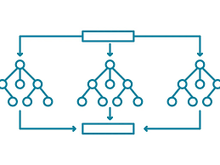
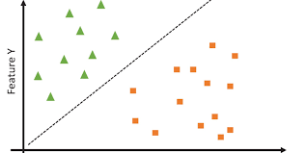
MODEL
BUILDING
Random Forest Algorithm
Random forest algorithm because it handles both categorical and numerical features well. It also provides feature importance, which helps in understanding which features are most important in predicting churn.
SUPPORT VECTOR MACHINE CLASSIFICATION
SVM is a powerful for classification algorithm. SVM is used because of its ability to handle large dataset well also SVM model is useful for binary classification like churn prediction.

Slide 22
MODEL
BUILDING
Random Forest Algorithm
Random forest algorithm because it handles both categorical and numerical features well. It also provides feature importance, which helps in understanding which features are most important in predicting churn.
SUPPORT VECTOR MACHINE CLASSIFICATION
SVM is a powerful for classification algorithm. SVM is used because of its ability to handle large dataset well also SVM model is useful for binary classification like churn prediction.

Slide 23
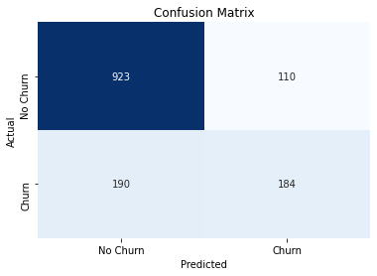
RESULT
AND
DISCUSSION
Random Forest Algorithm
The classification report metrics provide insights into the model's performance for each class.
The confusion matrix and classification report of the AdaBoost is as shown below:
 | precision | recall | f1-score | support
0 | 0.83 | 0.89 | 0.86 | 1033
1 | 0.63 | 0.49 | 0.55 | 374
accuracy |  |  | 0.79 | 1407

Slide 24
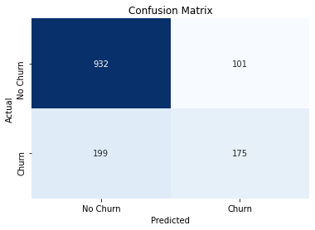
RESULT
AND
DISCUSSION
Support Vector Machine Algorithm
The classification report metrics provide insights into the model's performance for each class.
The confusion matrix and classification report of the SVM is as shown below:
 | precision | recall | f1-score | support
0 | 0.82 | 0.9 | 0.86 | 1033
1 | 0.63 | 0.47 | 0.54 | 374
accuracy |  |  | 0.79 | 1407

Slide 25
CONCLUSION
In our Customer Churn Prediction project, we aimed to identify the types of customers most likely to churn using the Telecom Customer Churn dataset. Here we used two machine learning models Random Forest and Support Vector Machine (SVM) and compared its accuracy. Both models performed equally with 79% though SVM model slighly performed better in predicting correctly. One of reasons for models low performance is due to imbalance data, in our dataset chruned customers are less compared to customers who stay. To imporve our models performance we can use hyper parameter tuning or perform prediction on balanced dataset.
With correlation matrix graph i was able to see which customer type are at high risk of churn customers on month-to-month contracts are more likely to churn compared to those with one-year or two-year contracts, meaning that short-term contracts come with a higher risk of losing customers. Customers without online security or tech support are more likely to churn, showing that the absence of these services increases the risk of churn. Customers with shorter tenure using the service, are also more likely to churn. Additionally, customers who have less total charge are more likely to churn, possibly because they don't enough service or facilities in their package.
Some of the recommendation to reduce churn rate is to provide targeted Offers for Low-Spending Customers, improved services for low spending customers and improved marketing strategies.

Slide 26
THANK YOU

